Slide 1
IoT Communication Protocols
Unit - IV

Slide 2
Topics to be covered
Need of various Protocols for IoT Communication
Messaging Protocols: MQTT, CoAP, XMPP
Transport Protocols: BLE, Li-Fi
Sensor Network Topology: Point-to-point, Mesh, Ring, Star

Slide 3
Need of protocols in IoT Communication
IoT systems are generally installed in some remote areas, whereas data processing and controlling is done at some other place.
So there is need for data transmission from one place to another, which is wireless or wired.
But every-time when the communication occurs between different devices, some common set of rules needs to be established
Protocols work for providing a proper communication channel through all the layers
  Messaging Protocols: For transfer of data.
  Transport Protocols: For transferring the message from Source to Destination.

Slide 4



Messaging Protocols
Messaging protocols are very important for the transfer of data in terms of messages.
They are useful for send/receive of a message to/from the cloud in IoT applications.
3 protocols are going to be discussed here
  MQTT: Message Queuing Telemetry Transport
  CoAP: Constrained Application Protocol
  XMPP: Extensible Messaging and Presence Protocol

Slide 5
Messaging Protocols: MQTT
Message Queuing Telemetry Transport
In IoT biggest challenge is Resource Constraint, so light-weight protocols are needed.
MQTT is one of the widely used protocols which is a very lightweight, meaning this can work with minimal resources and does not require any specific hardware architecture.

Slide 6
Messaging Protocols: MQTT Working
Works on “Publish – Subscribe” pattern.
  The publisher (node) sends a message to the MQTT Broker
  MQTT Broker transmits the message to the destinations who have subscribed.
Subscriber 1
Subscriber 2
Publisher
MQTT Broker
…
Subscriber n

Slide 7
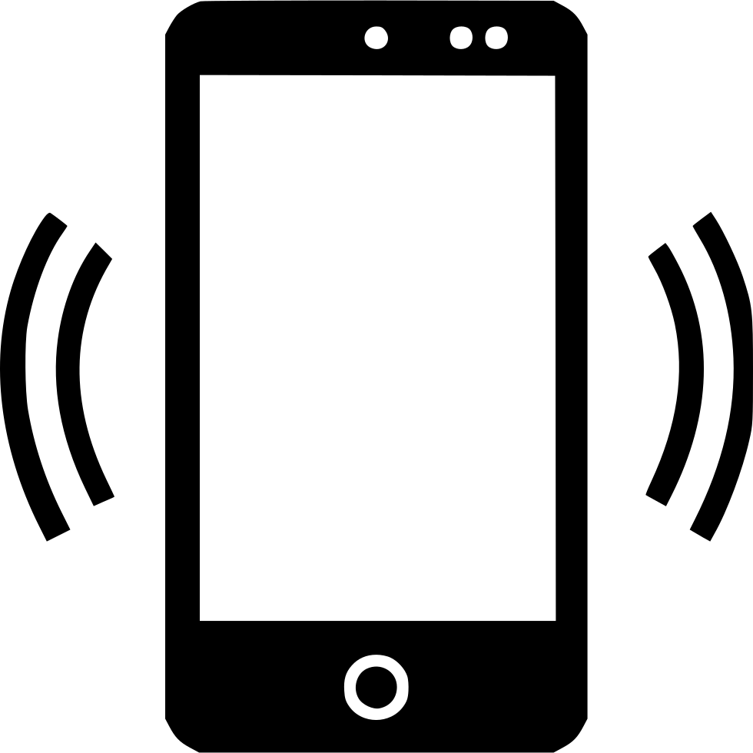


Messaging Protocols: MQTT
Suppose a temperature sensor is connected to any system and we want to monitor that temperature.
First of all the sensor will sense the temperature and send it to the controller.
Controller then reads and then it publishes the temperature to the MQTT Broker, where the registration was previously done under a particular ID (ex. Temperature).
Then MQTT Broker will transmit the value of that temperature to all the subscribers who have subscribed to this ID (Temperature).
Here an MQTT Broker can handle multiple IDs, so only those subscribers will get the data of Temperature who have subscribed for this data.
Subscribed to: Temperature
Subscribed to: Temperature
Subscribed to: Wind
Subscribed to: Temperature

Slide 8
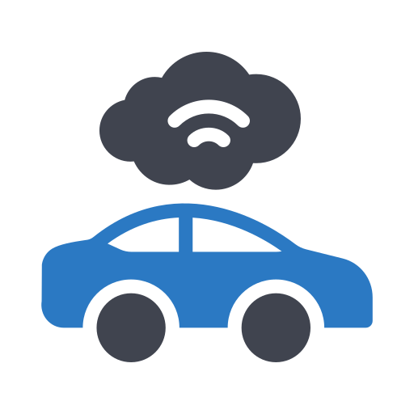

Messaging Protocols: MQTT
Communication can also be done in a 2-way manner, i.e. Subscriber of one data can be a Publisher of some other data as well.
Self Driving car will Publish location to broker and then to the system/server which is the subscriber of “CurrentLocation”.
Based on the selected destination and current location received, the system/server will publish “Direction” data to MQTT Broker and then to the car (Subscriber of: Direction).
Then the car will turn to the desired direction as per the data received.
Publisher: CurrentLocation
Subscriber: Direction
MQTT Broker
Publisher: Direction
Subscriber: CurrentLocation

Slide 9


Messaging Protocols: MQTT
Here client does not have any address like typical networking.
Broker simply filters messages based on subscribed “Topics”.
Then Message is circulated to respective subscribers like Television broadcasting.
In television broadcasting, a broadcaster will broadcast all the channels and the subscriber can view only channels for which they’ve subscribed.
Topic name is given in a String.

Slide 10
Messaging Protocols: MQTT
Node(s) in MQTT collects the information from sensors or some I/O devices, if it is a publisher.
Connects it to the messaging server MQTT Broker.
A special string – Topic is used to publish and identify the message, this message is relayed to all the subscribers.
Any node can be a subscriber or publisher or both, those are also known as Clients.

Slide 11
Messaging Protocols: MQTT
MQTT server has different configurations to manage QoS (Quality of Service).
There are 3 levels of QoS:
  Level 0: At most once (Best Effort, No Acknowledgement)
  Level 1: At least once (Acknowledged, retransmitted until acknowledged)
  Level 2: Exactly once (Request to send, Clear to send)
Some Cloud based web service providers/brokers for MQTT are available.
  HiveMQ
  Eclipse MQTT
  EMQX
  jMQTT
  Mosquitto
  Cloud MQTT etc.

Slide 12
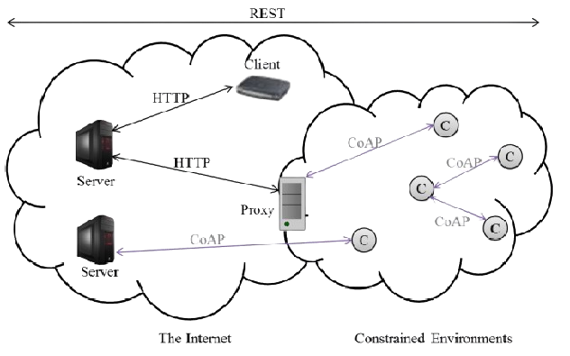
Messaging Protocols: CoAP
Constrained Application Protocol, designed by IETF (Internet Engineer Task Force), to work in a constrained environment such as those with low-bandwidth, high-latency, or limited processing power.
It is a one-to-one communication protocol.
It is lightweight like MQTT and uses less resources than HTTP.
HTTP runs over TCP, Connection-Oriented, where CoAP runs over UDP, Connection-less.

Slide 13
Messaging Protocols: CoAP
CoAP is based on the RESTful architecture (Representational State Transfer).
REST approach ensures the secure, fault tolerant and scalable system.
The CoAP optimizes the length of the datagram.
CoAP is connectionless protocol and it requires retransmission support.

Slide 14
Messaging Protocols: CoAP
Some characteristics include:
  RESTful protocol: Works on REST Principles, hence suitable for building scalable and resource-oriented applications.
  UDP as Transport protocol: Lightweight and connectionless, suitable for IoT applications.
  Low Overhead: Protocol specific overhead is less to conserve resources, designed to be efficient int terms of message size and processing requirements.
  Request-Response model: Similar to HTTP – Client -> Requests, Server -> Responds
  Observing Resource: Allows clients to receive message from server, whenever a resource changes its state.
  URI Support: URI model is used to identify resources over the network, similar to URLs in HTTP.
  Security: Uses DTLS (Datagram Transport Layer Security), ensuring Confidentiality and Integrity.
  Multicast Support: Allows single message to be sent to multiple clients.

Slide 15
Messaging Protocols: CoAP
CoAP has 4 layers
  UDP : Responsible for Transmitting/ Receiving the messages
  Messages: Deals with UDP layer and asynchronous switching
  Request-Response: Concerns communication methods to deal with messages, client can use GET/PUT/DELETE methods to transmit the message.
  Application: The higher layer for interaction with the user
Application
Request-Response
Messages
UDP

Slide 16
Messaging Protocols: CoAP
CoAP message layer supports 4 types of messages:
CONfitmable – Reliable Messagging (CON):
  Here Acknowledgement is recieved from the Server.
  If timed-out or Fail of Acnowledgement occurs, RST message from the server is sent as a response and the client will retransmit.
  Each message has a unique ID to Identify the acknowledgement received.
Client
Server
CON (ADDR)

Slide 17
Messaging Protocols: CoAP
NON-Confirmable – Non-reliable Messaging (NON):
  No reliability is ensured, as there is no acknowledgement by the server.
  Message has ID to unique each one individually.
  If the message is not processed by server, RST response is transmitted.
Client
Server
NON (Msg ID)

Slide 18
Messaging Protocols: CoAP
ACKnowledgement (ACK):
  Like traditional messaging, an acknowledgement message is sent to the client.
  Similar to simple handshaking.
  ACK denotes that the message is successfully processed in server without any errors/issues.
Client
Server
CON (ADDR)
ACK (ADDR)

Slide 19
Messaging Protocols: CoAP
ReSeT (RST):
  If server encounters some issue processing the message, server sends and RST message to the client.
  It informs the client that the message with the ID which was last sent should be disregarded.
Client
Server
CON (ADDR)
Error in Procssing
RST

Slide 20
Messaging Protocols: CoAP
3-Modes of communication in Request-Response Layer
  Piggy-Backed
  Separate Response
  Non-Confirmable Request and Response

Slide 21
Messaging Protocols: CoAP
Client
Server
Piggy-Baked:
  Client sends the data in a particular way (GET/PUT etc.) with token (ID) number and CON method.
  ACK is transmitted by server immediately with corresponding token (ID) and message
  If message is not received by the server or data is not available then server will send failure as acknowledgement
CON (ADDR)
GET(Temp)
(Token)
ACK (ADDR)
(Token)
36 ºC
Client
Server
CON (ADDR)
GET(Temp)
(Token)
ACK (ADDR)
(Token)
NOT FOUND

Slide 22
Messaging Protocols: CoAP
Client
Server
Separate Response:
  Client sends the data in a particular way (GET/PUT etc.) with token (ID) number and CON method. (Same as Piggy-Baked method)
  If server is busy at the moment, and empty
  After some time when the server has data ready, it sends a CON message with the data to client.
  In response to that, client sends the ACK message to Server.
CON (ADDR)
GET(Temp)
(Token)
ACK
.
.
.
.
CON (ADDR)
(Token)
36 ºC
ACK

Slide 23
Messaging Protocols: CoAP
Client
Server
Non-Confirmable Request-Response:
  Here client sends a message with particular method (GET, PUT etc.) with a token (ID) as a NON message.
  In response, server sends a NON message with a token (ID) and its data
NON (ID)
GET(Temp)
(Token)
NON (ID)
(Token)
36 ºC

Slide 24
Messaging Protocols: CoAP
CoAP message format is of 16-Bytes consisting various fields.
  V: CoAP Version, 2-bits unsigned int
  T: Message Type, 2-bits unsigned int
    0: CON
    1: NON
    2: ACK
    3: RST
  TKL: Token length, 4-bits unsigned int
0 | 1 | 2 | 3 | 4 | 5 | 6 | 7 | 8 | 9 | 10 | 11 | 12 | 13 | 14 | 15 | 16 | 17 | 18 | 19 | 20 | 21 | 22 | 23 | 24 | 25 | 26 | 27 | 28 | 29 | 30 | 31
V |  | T |  | TKL |  |  |  | Code |  |  |  |  |  |  |  | Message ID
Token (If any, with TKL Bytes Length)
Options (If any)
1 | 1 | 1 | 1 | 1 | 1 | 1 | 1 | Payload

Slide 25
Messaging Protocols: CoAP
  Code: Response Code of message
  Message ID: Message Identifier, to avoid duplication.
  Token: Optional field, size of the field is defined in TKL
  Options: 4-bytes Options field is available to indicate any options available.
  Payload: refers to the Payload Data (Actual Data) to be transmitted.
0 | 1 | 2 | 3 | 4 | 5 | 6 | 7 | 8 | 9 | 10 | 11 | 12 | 13 | 14 | 15 | 16 | 17 | 18 | 19 | 20 | 21 | 22 | 23 | 24 | 25 | 26 | 27 | 28 | 29 | 30 | 31
V |  | T |  | TKL |  |  |  | Code |  |  |  |  |  |  |  | Message ID
Token (If any, with TKL Bytes Length)
Options (If any)
1 | 1 | 1 | 1 | 1 | 1 | 1 | 1 | Payload

Slide 26
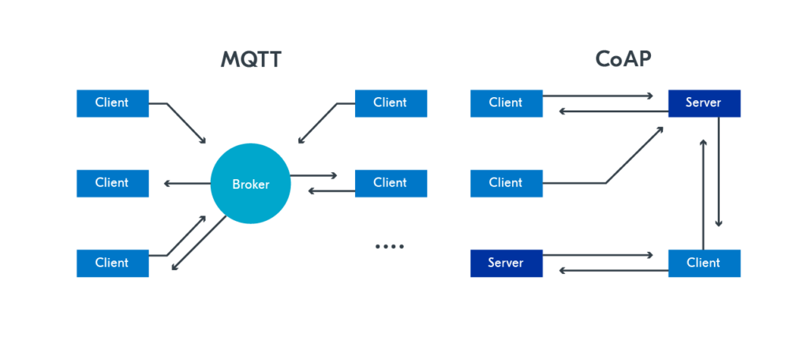
MQTT v/s CoAP

Slide 27
Messaging Protocols: XMPP
eXtensible Messaging and Presence Protocol
Designed for Messaging, Chat, Video & Voice calls and Collaboration.
Used for messaging services.
Previously known as Jabber.
X – eXtensible:
  Designed to accept and accommodate any changes.
  It is Extensible because of the open standard approach.
M – Messaging:
  Supports sending messages to the recipients in real-time.
P – Presence:
  Used to identify status of recipients as “Online”, “Offline”, “Busy”.
  This helps understand, whether the recipient is ready to receive or not.
P – Protocol:
  Defines set of standards for messaging and presence, hence protocol.

Slide 28
Messaging Protocols: XMPP
User requires following inbuilt features:
  Message Sending or Receiving.
  Understanding of the Presence / Absence of Recipient.
  Managing Subscription details.
  Managing Contacts List.
  Message Blocking service.

Slide 29
Messaging Protocols: XMPP
Architecture is as depicted in the figure.
XMPP client can communicate bidirectionally with XMPP server.
More than one clients can be connected to a single XMPP server.
XMPP Server may be connected to another XMPP Client or Servers.
XMPP Client
XMPP Server
XMPP Client
XMPP Client
XMPP Server
XMPP Server
XMPP Client
XMPP Client
XMPP Client

Slide 30
Messaging Protocols: XMPP
Initially XMPP was with TCP using open ended XML.
Later on, XMPP was developed based on HTTP.
XMPP has 2 different methods of communication while working with HTTP.
Polling (Pull Method): Message are stored in server and fetched/pulled by client using GET/POST HTTP.
Binding (Push method): Bidirectional-streams Over Synchronous HTTP (BOSH) enables the servers to push the messages to the clients when they are required.
Binding method is more effective than Polling.
Also both methods uses HTTP, so fetch and post activities can be done through firewall, which is allowed in a secured manner.

Slide 31


Transport Protocols
To transmit the data generated in a node through out the network, some set of transport protocols are available like TCP, UDP which are already used in various protocols.
But for some part of IoT system, an IoT device might not be capable of handling requirement of processing, transmission or reception of the messages.
For that some specific protocols are designed with some minor modifications in the already available protocols.
  Bluetooth 4.0 – BLE
  Light Fidelity – Li-Fi

Slide 32
Transport Protocols: BLE
Bluetooth Low Energy
BLE is open low energy short range radio communication technology.
This protocol is designed by Bluetooth Special Interest Group (SIG)
Working is same as Bluetooth in PAN (Personal Area Network)
BLE is considered superior to the Bluetooth due to some features like,
  Power Saving
  Supported by Android, iOS, BlackBerry etc.
  Supported by Computer OS like, Windows, MAC, Linux variants.
Because of this, BLE is widely used in areas like,
  Healthcare
  Environment
  Fitness (Wearable Devices)
  Proximity related applications
  Tracking Devices

Slide 33
Transport Protocols: BLE
There are some key features of BLE that makes it more suitable with IoT,
  Licence free and no additional cost is required.
  No restrictions to manufacturer
  BLE modules are inexpensive and affordable
  Modules are small in size, and less power requirements
  Range of BLE is higher than classic Bluetooth.

Slide 34
Transport Protocols: BLE
Architecture of BLE consists of mainly 3 components
  Application Block
    Here user application is accommodated.
    Interacts directly with Bluetooth Stack.
  Host Block:
    Upper layer of Bluetooth Stack.
  Controller Block
    Lower layer of Bluetooth Stack.
BLE
Application
Host
Controller

Slide 35
Transport Protocols: BLE
Application
Application
Generic Access Profile (GAP)
Generic Attribute Profile (GATT)
Host
Security Management Profile (SMP)
Attribute Protocol
(ATT)
Logical Link Control and Adaptation Protocol
(L2CAP)
Host Controller Interface (HCI)
Link Layer (LL)
Controller
Physical Layer (PHY)

Slide 36
Transport Protocols: BLE
Controller: It has 3 Components
  Host Controller Interface (HCI): Used to enable interoperability between hosts and controllers assembled by different manufacturers.
  Link Layer (LL): Defines the packet structure.
  Physical Layer (PHY): It takes care of transmission/reception, modulation/demodulation and analog-to-digital and vice-versa conversion.
Host Controller Interface (HCI)
Link Layer (LL)
Controller
Physical Layer (PHY)

Slide 37
Transport Protocols: BLE
Host: It has 6 Components
  Generic Access Profile (GAP): Device discovery, Connection Management and Security.
  Generic Attribute Profile (GATT): For Data Exchange process. Generic guidelines are given by GATT to Push data or read/write data.
  Attribute Protocol (ATT): Protocol for Accessing data.
  Logical Link Control and Adaptation Protocol (L2CAP): For Fragmentation/De-fragmentation of Application data. Also Multiplexing/de-multiplexing of channels over the shared Logical Link.
  Security Manager (SM): Takes care of Pairing, Authentication and Encryption.
  Host Controller Interface (HCI): Used to enable interoperability between hosts and controllers from different manufacturers
Generic Access Profile (GAP)
Generic Attribute Profile (GATT)
Host
Security Management Profile (SMP)
Attribute Protocol
(ATT)
Logical Link Control and Adaptation Protocol
(L2CAP)

Slide 38
Transport Protocols: BLE
Application: It has only 1 Component
  Application: It is same as Application Layer in OSI Model. Top most layer, which is responsible for UI, Logic and Data Representation.
Application
Application

Slide 39
Transport Protocols: BLE
Broadcasting in BLE:
  Meaning sending a message to more than one recipient
  Only One-way Comm.
  If receiver is in the vicinity of the broadcaster then the message will be received
  2 – Parties are involved in this:
    Broadcaster
    Observer
Observer
Observer
Observer
Broadcaster
Observer
Observer
Observer

Slide 40
Transport Protocols: BLE
Broadcaster:
  Sends a non-connectable advertising packets in frequent intervals to all those who are willing to collect which is similar to radio broadcast.
Observer:
  The observer will keep scanning predefined frequency to receive any non-connectable packets.

Slide 41
Transport Protocols: Li-Fi
Light Fidelity
Fastest communication protocol in current time.
It solves some problems of Wi-Fi Communications like,
  More secured than Wi-Fi
  More available bandwidth
  Less/No Congestion with more number of nodes connecting to a single central device.

Slide 42
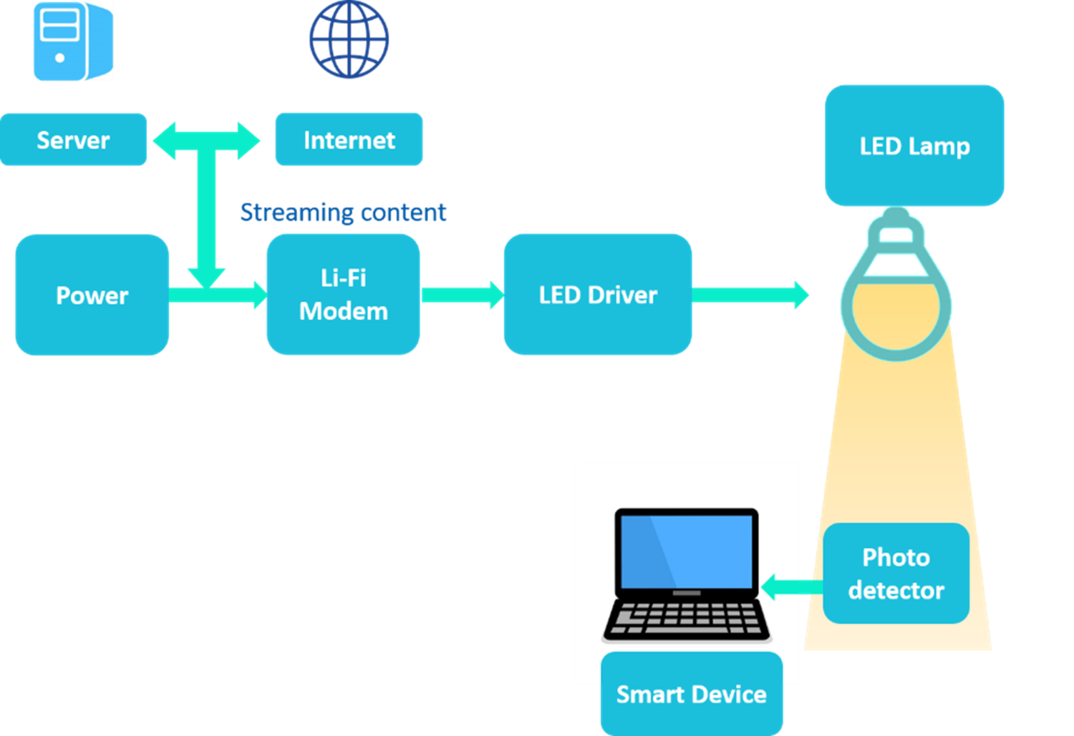
Transport Protocols: Li-Fi

Slide 43
Transport Protocols: Li-Fi
The Server wants to transmit the data to the receiver with very high speed. Server needs to be connected to Internet or Intranet.
The transmitted data generated will be converted into streaming content.
Then that content is given to a Lamp Driver, powered by an external source.
LED lamp is turned ON and OFF at a very high speed, which is at very high speed that human eyes can’t capture it.
The light is received by the photo detector and is passed on to the demodulation process and amplification to generate the data stream sent by transmitter.
The Received data stream is further given to the receiver (ex. PC, Mobile etc.) via some Application.
All components used for receiving the data is known as receiver dongle.

Slide 44
Transport Protocols: Li-Fi
Advantages:
  Extremely secure as Light cannot penetrate through walls and no data hijacking
  Fastest and Effective
  Effective alternate to RF communication
  Inexpensive, because light is generated through LEDs and detectors are also inexpensive.
Disadvantages:
  Can be implemented in short range only and no obstacle can be present between Lamp and Receiver dongle.
  Set-up requires some time.
  Bi-directional communication cannot be done, like sending data back from PC to the Server.

Slide 45
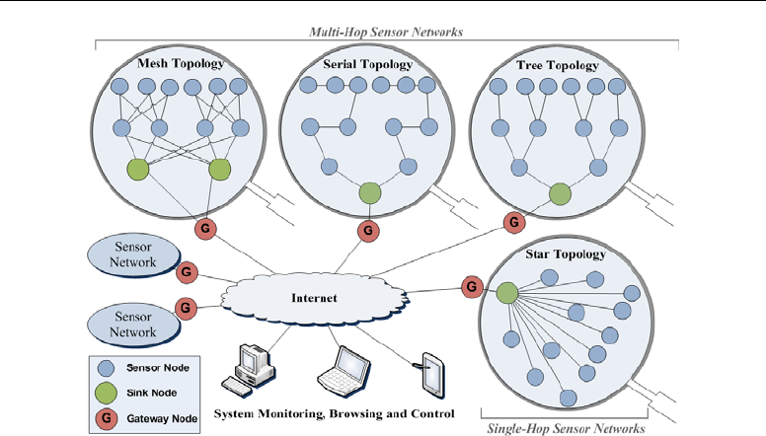
IoT Sensor Network Topologies
Sensors may be connected as a Single-hop Network, where each sensor Node sends the data directly to the Sink Node.
Or Multi-hop Network, where each Sensor Node relies on its neighbours to forward its sensory data to the Sink Node.

Slide 46
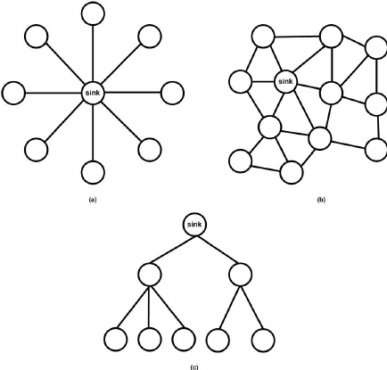
IoT Sensor Network Topologies
Point-to-Point (Star) Topology:
  Centralised Control:
    Central hub or base station manages and controls communication.
    Simplifies network administration and monitoring.
  Easy Expansion:
    Easy to add or remove nodes without disrupting the entire network.
    Scalable for small to medium-sized networks.
  Limited Scalability:
    Becomes less efficient and scalable for large networks due to increased traffic at the central hub.
  Single Point of Failure:
    The central hub represents a potential single point of failure.
    If the hub malfunctions, the entire network may be affected.

Slide 47
IoT Sensor Network Topologies
Mesh Topology:
  Connectivity:
    Can dynamically reroute traffic in the event of node or link failures.
    Offers self-healing capabilities to maintain connectivity.
  Redundancy:
    Redundant paths between nodes enhance reliability.
    Multiple communication routes reduce the impact of node or link failures.
  Scalability Challenges:
    May become complex and difficult to manage as the number of nodes increases.
    Routing algorithms must handle a potentially large number of connections.
  Increased Hardware Cost:
    Requires more hardware for interconnecting nodes.
    Can lead to higher implementation costs.

Slide 48
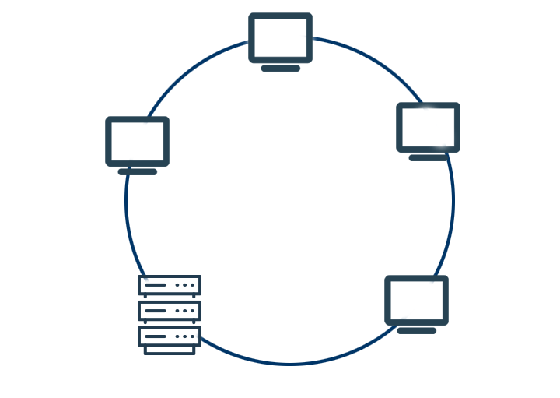
IoT Sensor Network Topologies
IoT Sensor Network Topologies
Ring Topology:
  Simplicity:
    Simple and straightforward to implement.
    Data travels in a predictable direction.
  Predictive Latency:
    Predictable latency for data transmission in a circular fashion.
    Suitable for applications with consistent timing requirements.
  Single Failure Impact:
    A break in the ring disrupts communication for the entire network.
    The failure affects all nodes between the break and the endpoints.
  Limited Scalability:
    Scaling the network may become challenging, especially with an increasing number of nodes.

Slide 49
IoT Sensor Network Topologies
Tree Topology:
  Hierarchical Structure:
    Organized in a hierarchical tree-like structure with a root node.
    Efficient for applications requiring centralized control.
  Efficient Data Routing:
    Data travels along predetermined paths from leaf nodes to the root.
    Effective for applications where data needs to be aggregated at a central point.
  Energy Efficiency:
    Can be energy-efficient as nodes closer to the leaves may operate on lower power.
    Suitable for battery-powered devices.
  Scalability Challenges:
    Scalability is limited, especially with a deep hierarchy.
    May face challenges with network expansion.

